Slide 1

Essential sensors
azhe.liu
2011.3.18

Slide 2
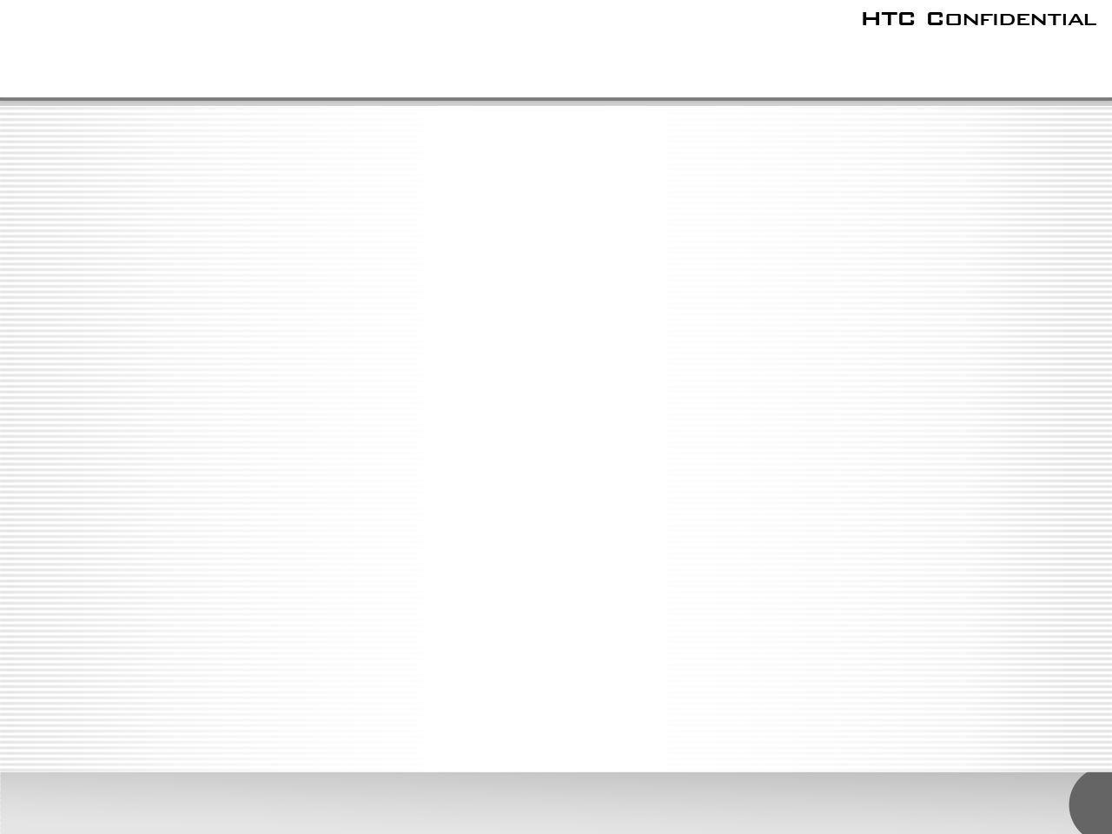
Outline
Sensor theory
  Proximity sensor
  Ambient Light sensor
  E-compass
  G-sensor
  Gyroscope
Sensors fusion
Calibration algorithms
  G-sensor
  Proximity sensor
  Ambient Light sensor

Slide 3
Proximity sensor
Theory:
It's like a switch to detech proximity or away by IR LED（红外发光二极管）。
Setting main params:
dutio ratio(占空率) （设置response time）
threshold level （设置接近或离开的距离界限）

Slide 4
Ambient light sensor
Theory:
To detect ambient light by Photodiode(光电二极管)。
Setting main params:
High/Low interrupt threshold window(产生中断的光强度阈值)
Algorithm:
several sample are averaged.

Slide 5
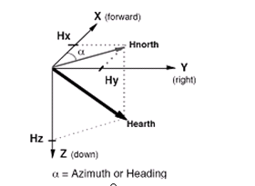

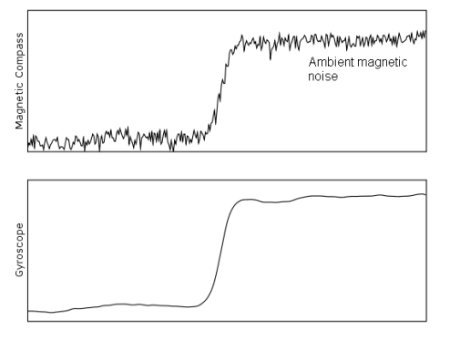
E-compass
Algorithm:
对水平方向的两个分量来说，他们的矢量和总是指向磁北的。罗盘中的航向角（Azimuth）就是当前方向和磁北的夹角。
Limitation:
Magnetic noise,such as speakers motors and RF.
Limitation of E-compass

Slide 6
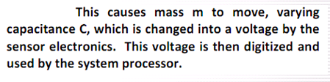
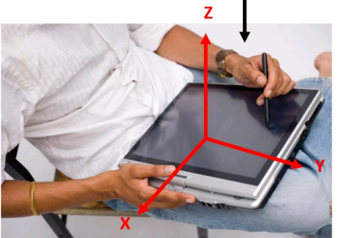
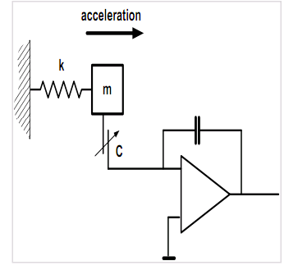
G-sensor
Theory:
C=Q/U

Slide 7
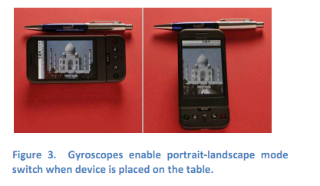
G-sensor
Limitations：
1.It can detect pitch,roll,but can't measure yaw.
2.Measurement is very poor quality during movement due to the fact that accelerometers also measure linear acceleration and add it to the gravitational measurement.

Slide 8
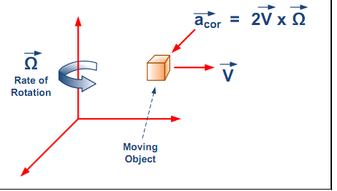
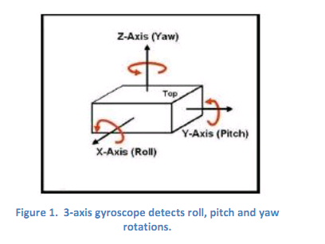
Gyroscope sensor
Theroy:
基于角动量守恒的理论设计出来的。
Limitations：
1.Gyro 输出角速度。角速度对时间积分后获得角度，会随时间产生积累偏差。
2.温度漂移。
C=Q/U

Slide 9
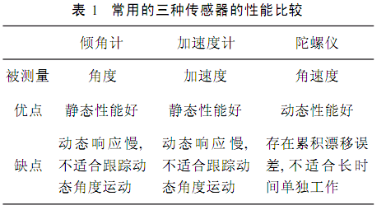
Sensors fusion
Gyro && G-sensor
To achieve 6DOF(Degree Of Freedom),moving of x,y,z-axis and rotation of pitch,roll,yaw-axis.
Accel vs Gyro in 6-axis
Gyro & G-sensor & Compass
  Compasses provide a fixed yaw reference by measuring magnetic North.

Slide 10
Calibration algorithms
Overview
write calibration data
read calibration data
SsdTestTools
sensor driver
driver data
global variable
kernel
cali data
driver node
tags
hboot
tag list
calibration data
ATAG_CORE
....
ATAG_ALS
ATAG_PS
ATAG_GS
....
ATAG_NONE
"mfg" partition
"mfg" partition

Slide 11
G-sensor calibration
write calibration data --SsdTestTool
device/vender/htc/SsdTestTool/gscal/main.c
gscal
IOCTL
offset data
driver node
"mfg" partition

Slide 12
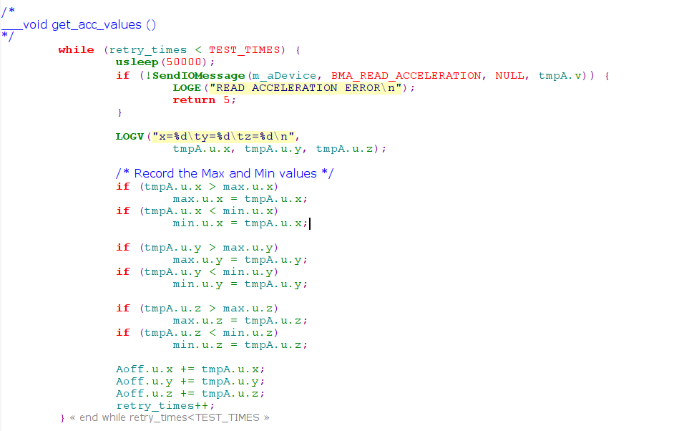
Write G-sensor calibration
get_acc_values

Slide 13
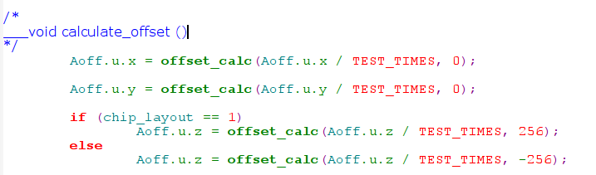
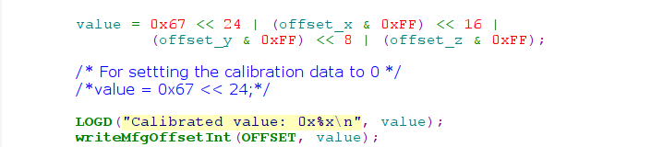
Write G-sensor calibration
calculate_offset
write "mfg" partition

Slide 14
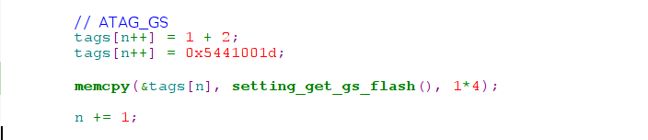

Read G-sensor calibration
Get ATAG_GS --hboot
hboot/common/boot.c

Slide 15

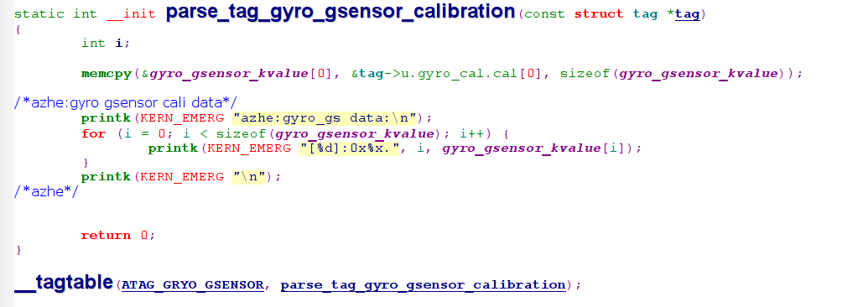
Read G-sensor calibration
parse tags --kernel
kernel/arch/arm/kernel/setup.c

Slide 16
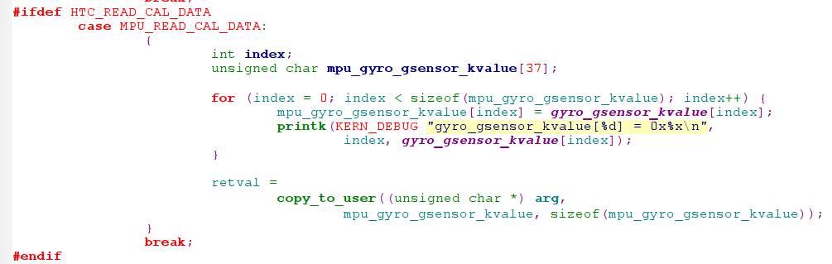
Read G-sensor calibration
get calibration --driver
kernel/drivers/misc/i2c/mpu350/mpu-dev.c
IOCTL to get calibration.

Slide 17
P-sensor calibration
write calibration data --SsdTestTool
device/vender/htc/SsdTestTool/pscal/pscal.c
pscal
adc data
offset data
sysfs
"mfg" partition

Slide 18
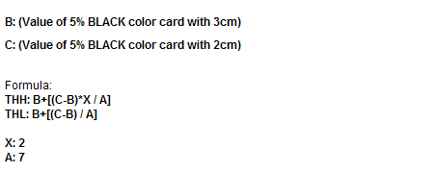
Write P-sensor calibration
Proximity sensor THH THL calculation

Slide 19
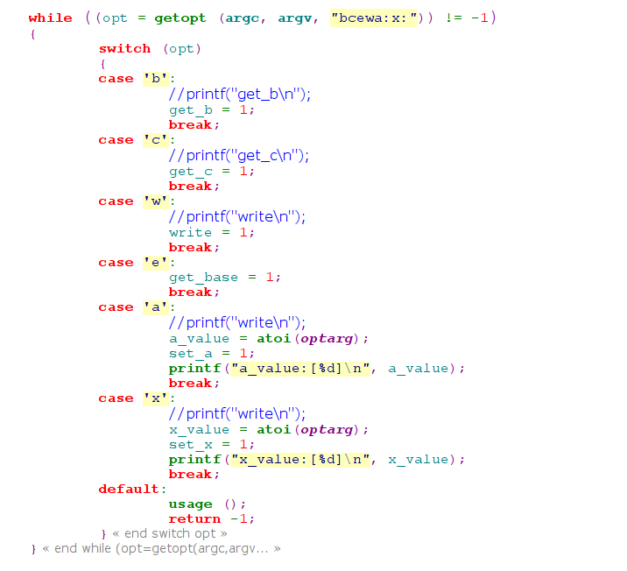
Write P-sensor calibration
write calibration data --SsdTestTool
Get a,x,b,c

Slide 20

Write P-sensor calibration
Get b_adc, c_adc
Write cali data to "mfg" FLASH
ps_kvalue1=(PS_CALIBRATED<<16) | (B<<8) | (C)
ps_kvalue2=(A<<24) | (x<<16) | (THH<<8) | (THL)

Slide 21

Read P-sensor calibration
Get ATAG_GS --hboot
hboot/common/boot.c

Slide 22
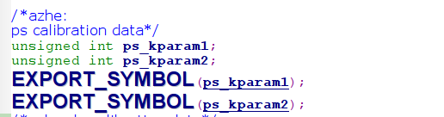
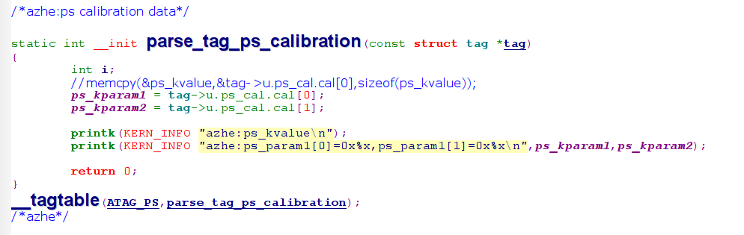
Read P-sensor calibration
parse tags --kernel
kernel/arch/arm/kernel/setup.c

Slide 23
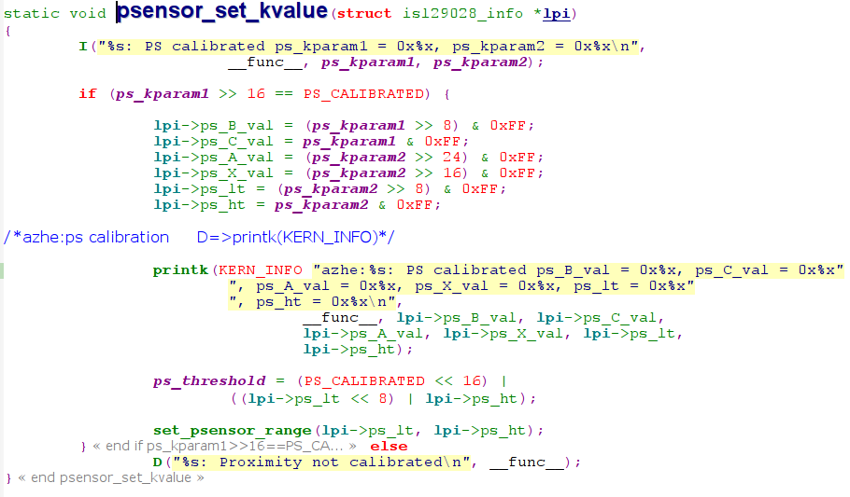
Read P-sensor calibration
Get calibration --driver
kernel/drivers/i2c/chips/isl29028.c

Slide 24
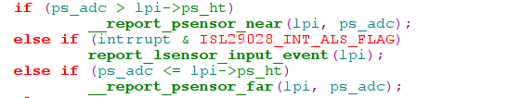
Read P-sensor calibration
Compare with thh ,tll with ps_adc to report far or near.

Slide 25
L-sensor calibration
PYD#TD使用870 Lux (ADC值為0x1C2)照度當作標準光源來做校正。
校正公式：

Slide 26
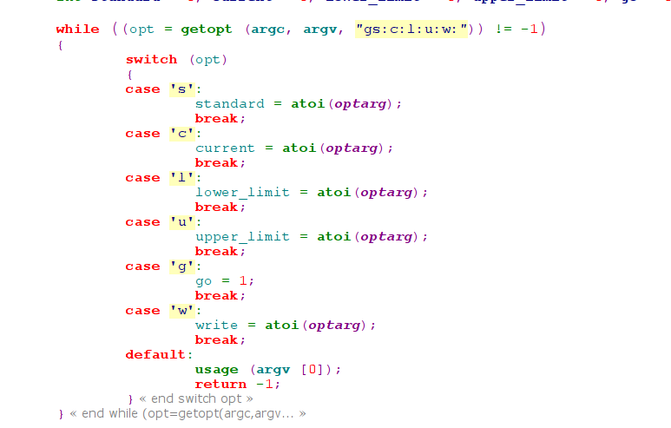
Write L-sensor calibration
write calibration data --SsdTestTool

Slide 27
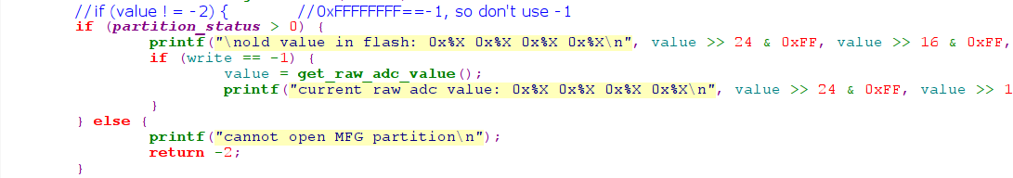
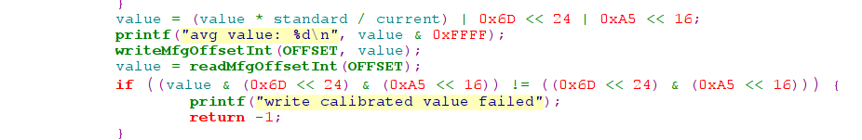
Write L-sensor calibration
Get ls raw adc data
Ls calibration data and write it to "mfg" partition.

Slide 28
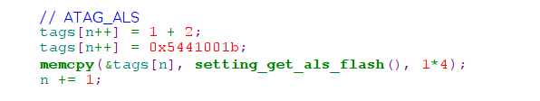
Read L-sensor calibration
Get ATAG_GS --hboot
hboot/common/boot.c

Slide 29


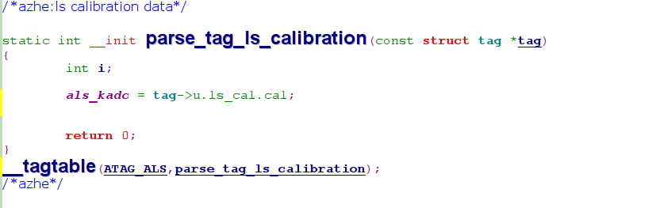
Read L-sensor calibration
parse tags --kernel
kernel/arch/arm/kernel/setup.c

Slide 30
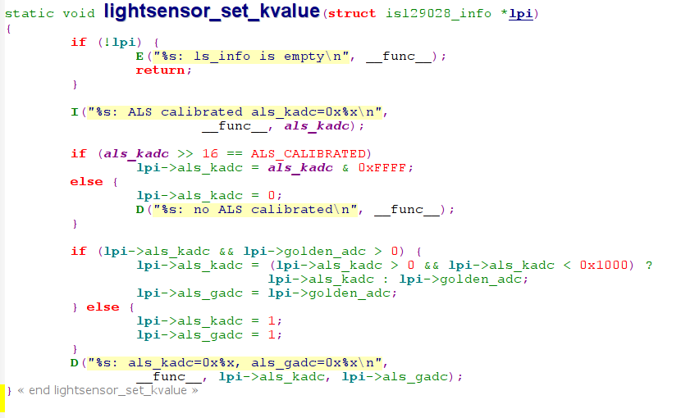
Read L-sensor calibration
Get calibration --driver
kernel/drivers/i2c/chips/isl29028.c

Slide 31
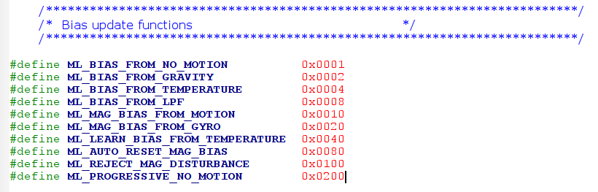
Calibration algorithms
Gyro bias from Accel & Compass
  ML_BIAS_FROM_GRAVITY
  This algorithm correlates the gyroscope data with the accelerometer data, and removes all drift in pitch,roll and yaw.
Gyro bias from Software Temperature Compensation
  ML_BIAS_FROM_GRAVITY
  Whenever a period of zero motion is detected,temperature will be polled, and a temperature compensation table will be updated to calculate linear fit(线性拟合).
Compass bias using gyros
  ML_MAG_BIAS_FROM_GYRO
Calculiate flags: mllite/ml.h

Slide 32
Thanks!

